Slide 1
Seminar on Firewalls and its types
Prepared Under the Guidance of
Prof. Shuchita Upadhyaya Ma’am
Submitted To: Submitted By:
Dr. Shuchita Ma’am Hitesh
Roll No 10
MCA 3rd Sem
Section B
Department of Computer Science and Applications
Kurukshetra University, Kurukshetra

Slide 2
Firewalls and its Types
Introduction
Firewalls are hardware and/or software designed to prevent unauthorized access to or from a private network.
Firewall isolates organizations’ internal network from larger Internet, allowing some packets to pass, blocking others.
Firewalls are placed at the junction or gateway between the two networks which is usually a private network and a public network such as the internet.

Slide 3
Types
Packet Filtering Firewall
Circuit Level Firewall
Application Proxy Firewall
Stateful Inspection Firewall
Cloud Firewall

Slide 4
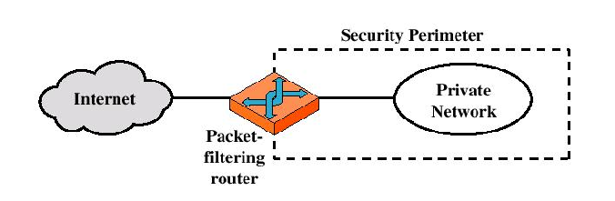
Packet Filtering Firewall
As the name suggests, it monitors network traffic by filtering incoming packets according to the information they carry.
To do so, it inspects the protocol, source IP address, destination IP, source port, and destination port. Depending on how the numbers match the access control list (rules defining wanted/unwanted traffic), the packets are passed on or dropped.

Slide 5
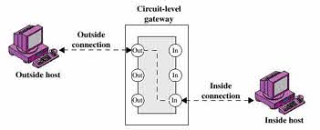
Circuit Level Gateway Firewall
Circuit-level gateways are a type of firewall that work at the session layer of the OSI model, observing TCP connections and sessions. Their primary function is to ensure the established connections are safe.
Information passed to a remote computer through a circuit level gateway appears to have originated from the gateway.

Slide 6
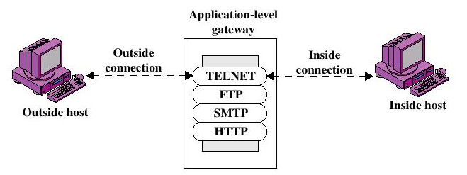
Application Proxy Firewall
A proxy firewall serves as an intermediate device between internal and external systems communicating over the Internet. It protects a network by forwarding requests from the original client and masking it as its own.
Doing so hides the client’s identification and geolocation, protecting it from any restrictions and potential attacks. The web server then responds and gives the proxy the requested information, which is passed on to the client.

Slide 7
Stateful Inspection Gateway Firewall
A stateful inspection firewall keeps track of the entire connection from start to end.
When starting a connection and requesting data, the stateful inspection builds a database (state table) and stores the connection information. In the state table, it notes the source IP, source port, destination IP, and destination port for each connection.
Unlike stateless/packet filtering, stateful firewalls inspect the actual data transmitted across multiple packets instead of just the headers.

Slide 8
Cloud Firewall
A cloud firewall or firewall-as-a-service (Faas) is a cloud solution for network protection. Like other cloud solutions, it is maintained and run on the Internet by third-party vendors.
Clients often utilize cloud firewalls as proxy servers, but the configuration can vary according to the demand. Their main advantage is scalability. They are independent of physical resources, which allows scaling the firewall capacity according to the traffic load.

Slide 9
Conclusion
One of the best things about a firewall from a security standpoint is that it stops anyone on the outside from logging onto a computer in your private network.
While this is a big deal for businesses, most home networks will probably not be threatened in this manner. Still, putting a firewall in place provides some peace of mind.

Slide 10
THANK YOU

